Slide 1
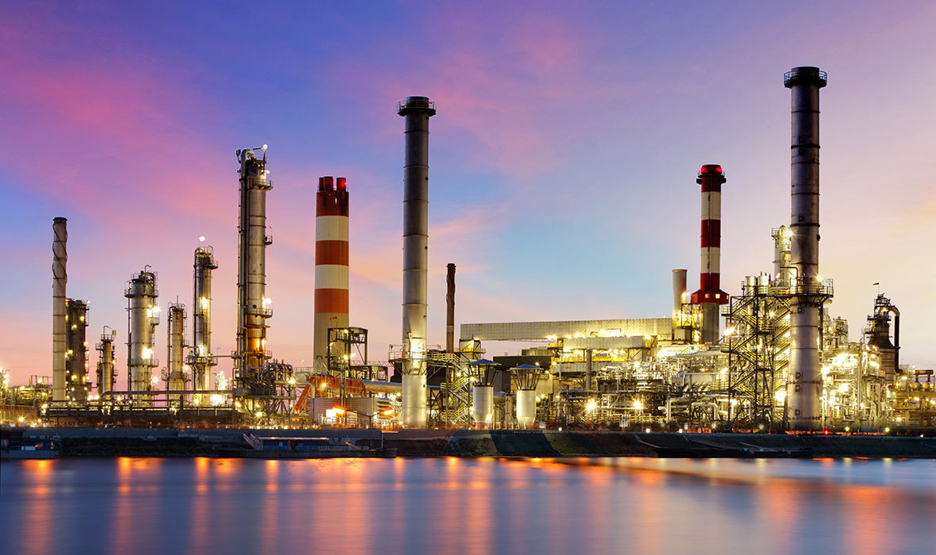
Phenol Production
Presented By-
Mohak Agarwal
Ankit Kothari
Suraj Lungase
Tanmay Tiwari

Slide 2
Introduction
By-
Mohak agarwal
(2013A1PS887G)

Slide 3
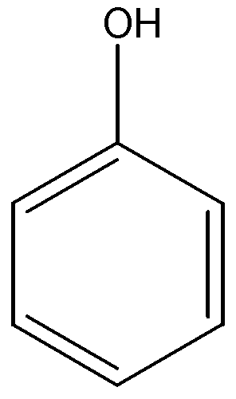
Introduction
Phenol is an aromatic organic compound with molecular formula C₆H₅OH
Physical Properties:
MW : 94
MP : 40.9 °C
BP : 181.8 °C
Density : 1071 kg/m³

Slide 4
Uses of Phenol
http://www.greener-industry.org.uk/pages/phenol/2PhenolUses.htm
Notes:
Xylenols- smoked foods, coffee, antioxidants

Slide 5
Uses of Phenol
Intermediate | End Use/Products
Bisphenol A | Used to produce epoxy resins for paints coatings and mouldings, and in polycarbonate plastics, familiar in CDs and domestic electrical appliances
Caprolactum | Manufacture of nylon and polyamide plastics for a wide range of products, including carpets, clothing, fishing nets, moulded components and packaging.
Aniline | Used as an antioxidant in rubber manufacture, and as an intermediate in herbicides, dyes
Alkyl phenols | Used in the manufacture of surfactants, detergents and emulsifiers, and also in insecticide and plastics production.
Phenolic resins | Used in manufacture of adhesives, binders, exterior Plywood, electric boards and switches

Slide 6
Production in India
More than 50% of the phenol that is produced is used in the manufacture of phenolic resins
Rest 50% is used in the manufacture of rubber chemicals, pharmaceuticals, and cellulose acetate explosives
These are the major companies manufacturing phenol in India :
Bengal chemicals and pharmaceuticals, Kolkata
Herdillia chemicals, Thane
HOCL, Ernakulum
Neshiel Chemical Pvt. Ltd., Ahmedabad, Gujarat

Slide 7
Methods Of Production
Phenol can be produced from many sources such as :
Cumene
Toluene
Benzene
Depending upon these raw materials, various chemical transformations and underlying physical principles apply

Slide 8
Phenol Production from Cumene
Presently the cumene-to-phenol process is the predominant route for the production of phenol
More than 97% of the phenol worldwide is produced by this process
The process was ﬁrst reported by Hock and Lang
After World War II, the cumene-to-phenol process was developed on a commercial scale by The Distillers Co. in Great Britain and the Hercules Powder Company in the USA
The ﬁrst production plant was commenced in 1952 in Shawinigan, Canada
L. Pilato (ed.), Phenolic Resins: A Century of Progress

Slide 9
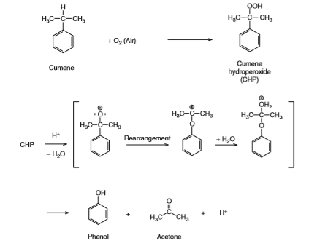
Reactions Involved

Slide 10
Process Flowsheet

Slide 11
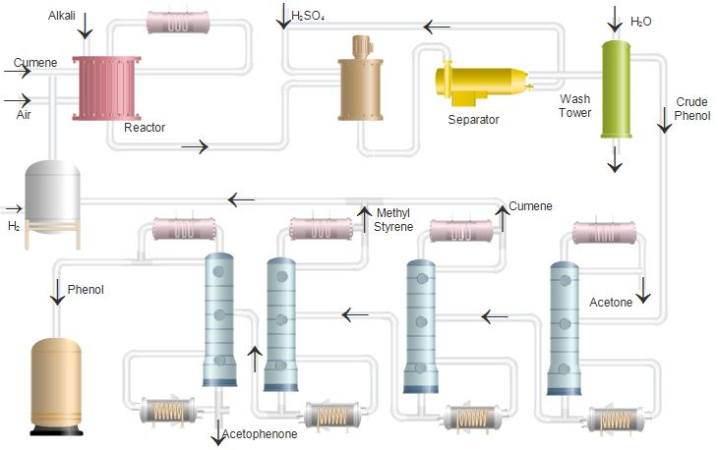

Slide 12
Process Description
By-
Ankit Kothari
(2013A1ps923g)

Slide 13
Process Description
Complete process consists of 7 steps:
1. Oxidation
2. Reaction
3. Washing Of Cleavage
4. Distillation Of Acetone
5. Recovery Of Cumene
6. Purification Of AMS/
7. Distillation Of Phenol

Slide 14

Oxidation
Cumene is oxidized using compressed air and washed with a caustic solution to remove impurities that can affect the oxidation
S0₂ free dry air is fed through the bottom to each one of three reactors (Oxidizers) inter connected in series under pressure and temperature conditions
Cumene is fed to the first reactor to form Cumene hydro peroxide (CHP) in concentrations of upto12% ,the mixture of Cumene and CHP overflows to the 2nd and then to 3rd oxidizer to reach 17% and 21% as CHP respectively

Slide 15
Oxidation
This reaction is exothermic so that vapours with traces of cumene are carried in the spent gases stream (ΔH_{rxn} = -117 kJ/mol )
Cumene is recovered in a condensation/separation system and after washing (to remove organic acids) reintegrated to the oxidation process
Cumene free exhausted gases are sent to the atmosphere
Operating Conditions:
Temperature : 80°C–120°C
Pressure : 100 kPa–700 kPa

Slide 16

Reaction
The reaction system is to cleavage the CHP to produce Phenol and Acetone with the lowest delivering of high boiling point by products and the highest output of one market demand by product: Alpha Methyl Styrene(AMS)
The system is formed of 2 reactors and uses Sulfuric Acid to catalyse the reaction

Slide 17
Reaction
In the1st reactor the following reactions take place :
Partial Cleavage of CHP
Dehydration of Carbinol to deliver AMS
Reaction of Carbinol with CHP to produce Di Cumyl Peroxide (DCP)
Reaction Conditions :
Temperature : 50-53°C
Concentration of Cumene in CHP ranging between 10 to15%
Less than 1.0% of Water content in produce of reaction

Slide 18
Reaction
In the 2nd reactor following reactions are carried into effect :
Total cleavage of CHP to Phenol and Acetone
Conversion of DCP to AMS, Phenol and Acetone
Conversion of Carbinol to AMS
Reaction Conditions :
Temperature : 125-140°C
Minimal residence time in the system
To prevent vaporization of Acetone the 2nd reactor operates pressurized at 7.5–8 kg/cm²

Slide 19

Washing Of Cleavage
Before distillate the produce of cleavage, the catalyser (Sulfuric Acid) and organic acids should be neutralized to avoid by products and to prevent corrosion to equipment
Neutralization is made by means of aqueous sodium sulfate solution and adding alkaline pH sodium phenate solution to neutralize the extracted acid and to free Phenol from the phenate to obtain more sodium sulfate

Slide 20

Distillation of Acetone
In the Crude Acetone column, product of Cleavage is preheated and then fed as a mixture of liquid and vapour. On the top crude Acetone is obtained and part of this stream is sent back as reflux. The balance is fed to the Lights Column
In the Lights Column low boiling point impurities are taken out on the top. Lights free Acetone in the bottom of the column is fed to the Acetone Stripping column.

Slide 21
Distillation of Acetone
Bottoms of lights column are received in the Stripping Column where Acetone is removed from the feeding stream composed of Acetone, Cumene, AMS and other components heavier than Acetone.
The Pure Acetone Column operates as a Rectifier Tower, it processes the distillate product coming out from the top of the Stripping Column. Acetone of 99.65% Purity is obtained on the top, part of this Acetone is recycled as reflux to the column for the rectification and the balance is sent to the Pure Acetone Storage Tank.

Slide 22
Recovery of Cumene
The bottom product from the crude acetone column is sent to the cumene column
The column of Cumene separates a stream of AMS free Cumene/light impurities on the top. This product is condensed and partially being recycled to the column and the balance sent to the stage of washing of cumene as recovered product to be oxidized.
In the bottom of the column lights free AMS/Heavies and phenol remain to be fed to the column of Purification of AMS.

Slide 23
Purification of AMS
The Column for Purification of Alpha Methyl Styrene receives the stream coming on from the bottom of the Column of Cumene.
On the top AMS is obtained and condensed to be stored in a vessel. Part of the stored material is sent back to the column as a reflux the balance is sent to the storage tank
The AMS produced has a purity of at least 99.51%

Slide 24
Distillation of Phenol
The bottom produce of the AMS purification column is the feed to this column
On the top phenol is obtained and condensed to be stored in a vessel. Part of the stored material is sent back to the column as a reflux, the balance is sent to the storage tank
The bottom product contains acetophenone and heavy impurities
The phenol produced has a purity of 99.97%

Slide 25
Pollution and Environment
By-
Suraj lungase
(2013a1ps922g)

Slide 26
Pollution & Environmental Issues
Since CHP is explosive after a certain limit, it should not get accumulated beyond a specified concentration in any section of the units
Phenol has a very characteristic and heavy odour, so its emissions can lead to community odour problems
Phenol and its solutions are flammable and during fire, it may decompose into CO and CO₂
Effluent water may contain phenol which is toxic to aquatic animals and in general fish appear to be more sensitive
Source: Odours from Stationary and Mobile Sources

Slide 27
Modifications for Pollution Prevention
In-process recovery and recycle of CHP & phenol
Benefits:
2-3 % increase in phenol production
High recovery (99.3%) of phenol and hazardous organics in waste streams
50% decrease in biological loading on downstream wastewater treatment system
Eliminate transfer of pollutants to other waste streams
Source: Proceedings of the 51st Purdue Industrial Waste Conference

Slide 28
Modifications for Pollution Prevention
Recovery and recycle of phenol and acetone from vent system
Benefits
Reduces potential for accidental releases
Reduces by-product formation
99.9% recovery of regulated hazardous organics from steady state vent and emergency relief systems
Eliminates release potential due to corrosion
Satisfies near-future emissions control standards
Source: Proceedings of the 51st Purdue Industrial Waste Conference

Slide 29
Modifications for Pollution Prevention
Recovery and recycle of phenol oxidizer off-gases and CHP concentration vent gases
Benefits
99.9% reduction in atmospheric emissions
Eliminates transfer of pollutants to other waste streams
99.9% recovery of regulated hazardous organics from oxidizer and CHP concentration systems
Source: Proceedings of the 51st Purdue Industrial Waste Conference

Slide 30
Process Equipment and Market Analysis
By-
Tanmay Tiwari
(2013a1ps890g)

Slide 31
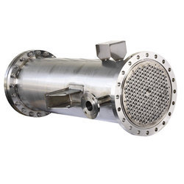
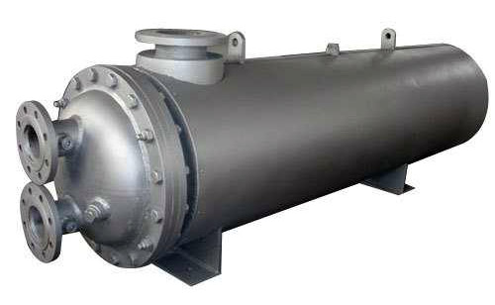
Process Equipment
Heat Exchanger
Condenser
Radiant Heat Exchangers Pvt. Ltd.
Armstrong
Thermax India Ltd.
Alpha Technovac LLP

Slide 32
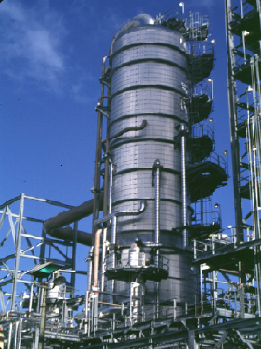
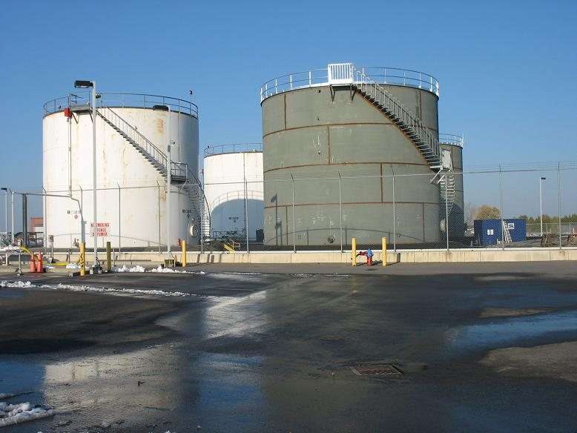
Process Equipment
Vacuum Distillation Column
Storage Tank
Bharat tanks and Vessels
Maleta Cyclic Distillation LLC
Rufouz Hitek Engineers Pvt. Ltd.

Slide 33
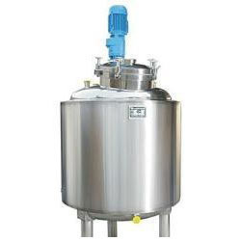
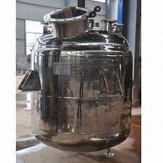
Process Equipment
Reactor
Agitated Reactor
Nes India Engineers
Kalina Engineering Pvt. Ltd.
Aum Industrial Steels Ltd.

Slide 34
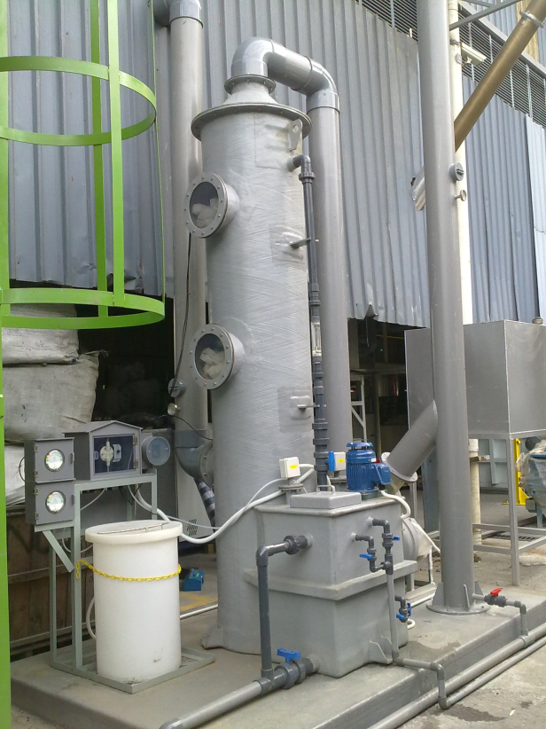
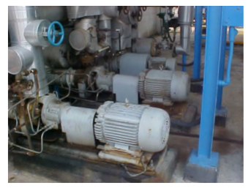
Process Equipment
Scrubber
Pump
Rufouz Hitek Engineers Pvt. Ltd.
Shakti Pumps Ltd.
Kirloskar Brothers Ltd.

Slide 35
Market Analysis
The global demand for phenol has been steadily increasing over the last 10 years.
In 2000, global phenol demand stood at 6,072,774 tons, before increasing to 7,934,218 tons in 2010.
A significant portion of the increase in demand for phenol was from the Asia-Pacific region, and this is expected to continue in the forecast period.
The Asia-Pacific region is expected to account for 51.2% of global phenol demand in 2020.
The global demand for phenol will increase to reach 11,576,620 tons by 2020
Source: http://www.marketresearch.com/corporate/aboutus/press.asp?view=3&article=2548&g=1

Slide 36
Major Phenol Producers
Company | Capacity in thousands of tons per year*
INEOS Phenol | 1870
Sunoco | 800
Mitsui Chemicals | 750
Shell | 600
CEPSA Quimica | 600
Polimeri Europa | 480
FCFC | 400
* 2014 data
Notes:
ndia’s phenol imports totalled 216,053 tonnes in 2014, an 8.1% increase from 2013, according to data supplied by market participants.

Slide 37
References
http://www.ippe.com/plants/600551/phenol.pdf
http://www.ineos.com/businesses/ineos-phenol/markets
http://www.greener-industry.org.uk/pages/phenol/7PhenolProdMethods2.htm
http://www.essentialchemicalindustry.org/chemicals/phenol.html
https://www3.epa.gov/airtoxics/hlthef/cumene.html

Slide 38
Thank You!

